Slide 1
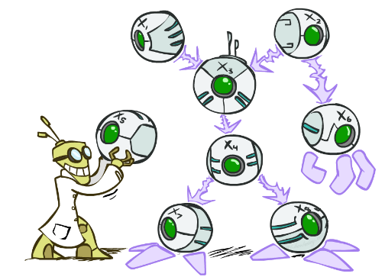
CS 188: Artificial Intelligence
Bayes’ Nets
Instructors: Dan Klein and Pieter Abbeel --- University of California, Berkeley
[These slides were created by Dan Klein and Pieter Abbeel for CS188 Intro to AI at UC Berkeley. All CS188 materials are available at http://ai.berkeley.edu.]
Notes:
Please retain proper attribution, including the reference to ai.berkeley.edu. Thanks!

Slide 2

Probabilistic Models
Models describe how (a portion of) the world works
Models are always simplifications
May not account for every variable
May not account for all interactions between variables
“All models are wrong; but some are useful.” – George E. P. Box
What do we do with probabilistic models?
We (or our agents) need to reason about unknown variables, given evidence
Example: explanation (diagnostic reasoning)
Example: prediction (causal reasoning)
Example: value of information
Notes:
George Box: All models are wrong; some of them are useful

Slide 3

Independence

Slide 4

Independence
Two variables are independent if:
This says that their joint distribution factors into a product two simpler distributions
Another form:
We write:
Independence is a simplifying modeling assumption
Empirical joint distributions: at best “close” to independent
What could we assume for {Weather, Traffic, Cavity, Toothache}?

Slide 5
Example: Independence?
T | P
hot | 0.5
cold | 0.5
T | W | P
hot | sun | 0.4
hot | rain | 0.1
cold | sun | 0.2
cold | rain | 0.3
T | W | P
hot | sun | 0.3
hot | rain | 0.2
cold | sun | 0.3
cold | rain | 0.2
W | P
sun | 0.6
rain | 0.4

Slide 6


Example: Independence
N fair, independent coin flips:
H | 0.5
T | 0.5
H | 0.5
T | 0.5
H | 0.5
T | 0.5

Slide 7
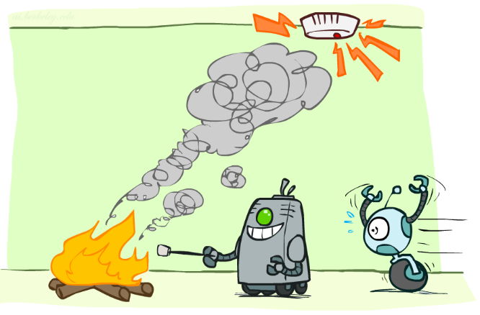
Conditional Independence

Slide 8
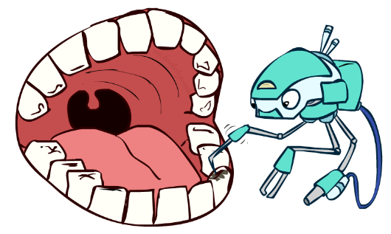
Conditional Independence
P(Toothache, Cavity, Catch)
If I have a cavity, the probability that the probe catches in it doesn't depend on whether I have a toothache:
P(+catch | +toothache, +cavity) = P(+catch | +cavity)
The same independence holds if I don’t have a cavity:
P(+catch | +toothache, -cavity) = P(+catch| -cavity)
Catch is conditionally independent of Toothache given Cavity:
P(Catch | Toothache, Cavity) = P(Catch | Cavity)
Equivalent statements:
P(Toothache | Catch , Cavity) = P(Toothache | Cavity)
P(Toothache, Catch | Cavity) = P(Toothache | Cavity) P(Catch | Cavity)
One can be derived from the other easily

Slide 9

Conditional Independence
Unconditional (absolute) independence very rare (why?)
Conditional independence is our most basic and robust form of knowledge about uncertain environments.
X is conditionally independent of Y given Z
if and only if:
or, equivalently, if and only if

Slide 10
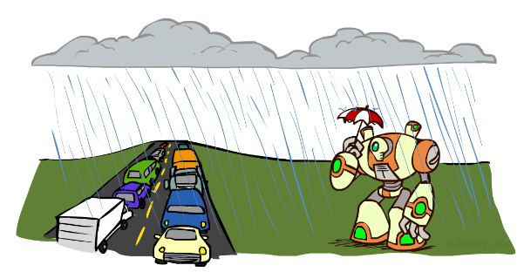
Conditional Independence
What about this domain:
Traffic
Umbrella
Raining

Slide 11

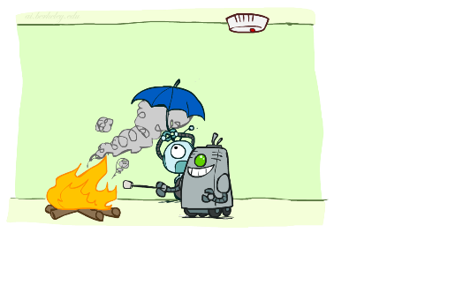
Conditional Independence
What about this domain:
Fire
Smoke
Alarm

Slide 12

Conditional Independence and the Chain Rule
Chain rule:
Trivial decomposition:
With assumption of conditional independence:
Bayes’nets / graphical models help us express conditional independence assumptions

Slide 13


Ghostbusters Chain Rule
Each sensor depends only on where the ghost is
That means, the two sensors are conditionally independent, given the ghost position
T: Top square is red B: Bottom square is red G: Ghost is in the top
Givens:
P( +g ) = 0.5
P( -g ) = 0.5
P( +t | +g ) = 0.8 P( +t | -g ) = 0.4 P( +b | +g ) = 0.4 P( +b | -g ) = 0.8
P(T,B,G) = P(G) P(T|G) P(B|G)
T | B | G | P(T,B,G)
+t | +b | +g | 0.16
+t | +b | -g | 0.16
+t | -b | +g | 0.24
+t | -b | -g | 0.04
-t | +b | +g | 0.04
-t | +b | -g | 0.24
-t | -b | +g | 0.06
-t | -b | -g | 0.06

Slide 14
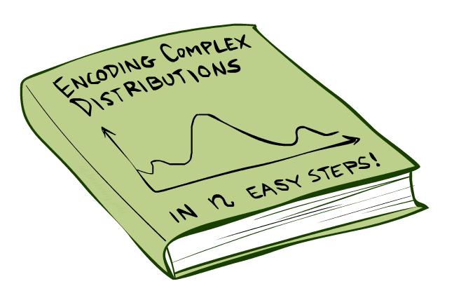
Bayes’Nets: Big Picture

Slide 15

Bayes’ Nets: Big Picture
Two problems with using full joint distribution tables as our probabilistic models:
Unless there are only a few variables, the joint is WAY too big to represent explicitly
Hard to learn (estimate) anything empirically about more than a few variables at a time
Bayes’ nets: a technique for describing complex joint distributions (models) using simple, local distributions (conditional probabilities)
More properly called graphical models
We describe how variables locally interact
Local interactions chain together to give global, indirect interactions
For about 10 min, we’ll be vague about how these interactions are specified

Slide 16
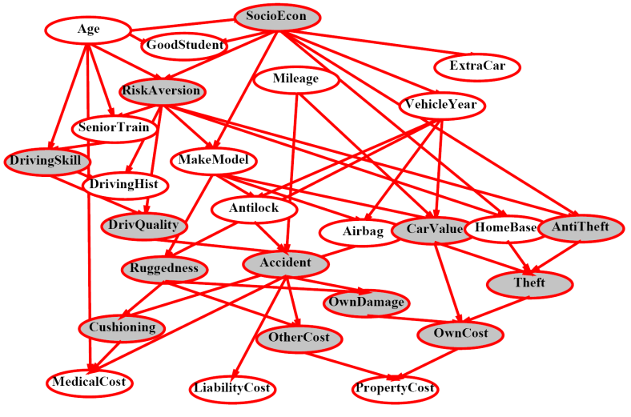
Example Bayes’ Net: Insurance

Slide 17
Example Bayes’ Net: Car

Slide 18
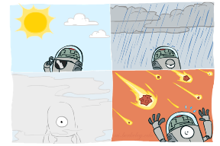
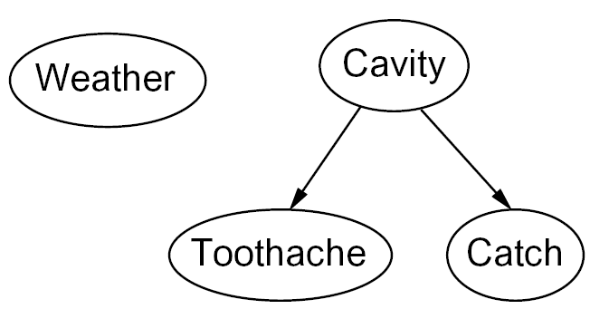

Graphical Model Notation
Nodes: variables (with domains)
Can be assigned (observed) or unassigned (unobserved)
Arcs: interactions
Similar to CSP constraints
Indicate “direct influence” between variables
Formally: encode conditional independence (more later)
For now: imagine that arrows mean direct causation (in general, they don’t!)

Slide 19

Example: Coin Flips
N independent coin flips
No interactions between variables: absolute independence
X₁
X₂
X_{n}

Slide 20
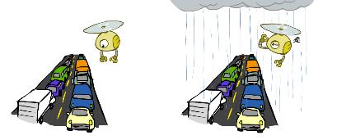
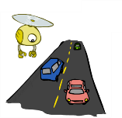
Example: Traffic
Variables:
R: It rains
T: There is traffic
Model 1: independence
Why is an agent using model 2 better?
Model 2: rain causes traffic
R
R
T
T

Slide 21
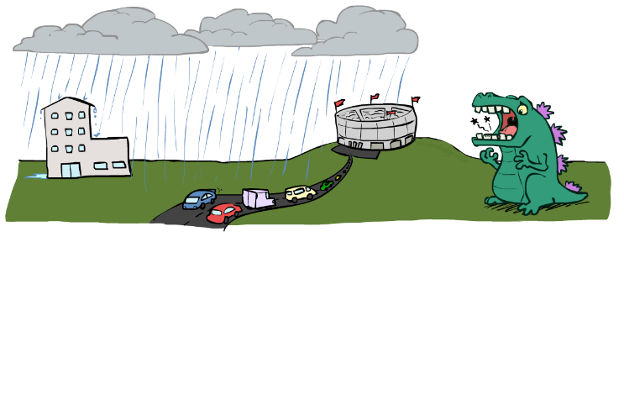
Example: Traffic II
Let’s build a causal graphical model!
Variables
T: Traffic
R: It rains
L: Low pressure
D: Roof drips
B: Ballgame
C: Cavity

Slide 22
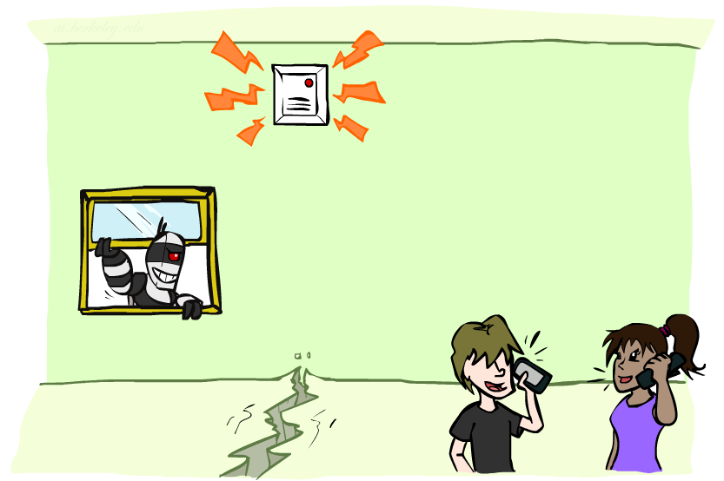
Example: Alarm Network
Variables
B: Burglary
A: Alarm goes off
M: Mary calls
J: John calls
E: Earthquake!

Slide 23
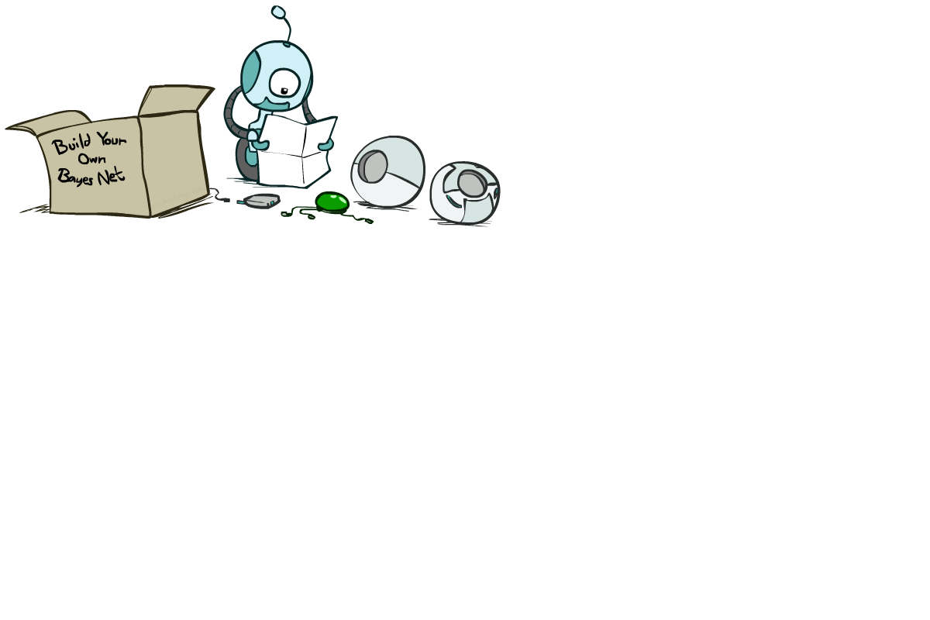
Bayes’ Net Semantics

Slide 24
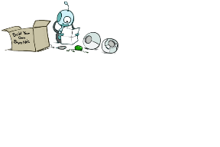


Bayes’ Net Semantics
A set of nodes, one per variable X
A directed, acyclic graph
A conditional distribution for each node
A collection of distributions over X, one for each combination of parents’ values
CPT: conditional probability table
Description of a noisy “causal” process
A₁
A_{n}
X
A Bayes net = Topology (graph) + Local Conditional Probabilities

Slide 25


Probabilities in BNs
Bayes’ nets implicitly encode joint distributions
As a product of local conditional distributions
To see what probability a BN gives to a full assignment, multiply all the relevant conditionals together:
Example:

Slide 26


Probabilities in BNs
Why are we guaranteed that setting
results in a proper joint distribution?
Chain rule (valid for all distributions):
Assume conditional independences:
→ Consequence:
Not every BN can represent every joint distribution
The topology enforces certain conditional independencies

Slide 27

Example: Coin Flips
X₁
X₂
X_{n}
h | 0.5
t | 0.5
h | 0.5
t | 0.5
h | 0.5
t | 0.5
Only distributions whose variables are absolutely independent can be represented by a Bayes’ net with no arcs.
Notes:
demo

Slide 28

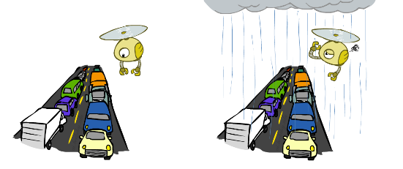

Example: Traffic
R
+r | 1/4
-r | 3/4
+r | +t | 3/4
 | -t | 1/4
T
-r | +t | 1/2
 | -t | 1/2
Notes:
demo

Slide 29
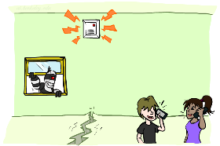
Example: Alarm Network
B | P(B)
+b | 0.001
-b | 0.999
E | P(E)
+e | 0.002
-e | 0.998
Burglary
Earthqk
Alarm
B | E | A | P(A|B,E)
+b | +e | +a | 0.95
+b | +e | -a | 0.05
+b | -e | +a | 0.94
+b | -e | -a | 0.06
-b | +e | +a | 0.29
-b | +e | -a | 0.71
-b | -e | +a | 0.001
-b | -e | -a | 0.999
John calls
Mary calls
A | J | P(J|A)
+a | +j | 0.9
+a | -j | 0.1
-a | +j | 0.05
-a | -j | 0.95
A | M | P(M|A)
+a | +m | 0.7
+a | -m | 0.3
-a | +m | 0.01
-a | -m | 0.99
Notes:
demo

Slide 30
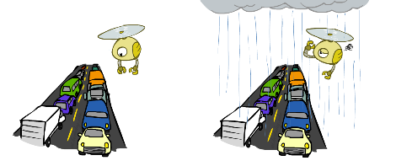

Example: Traffic
Causal direction
R
+r | 1/4
-r | 3/4
+r | +t | 3/16
+r | -t | 1/16
-r | +t | 6/16
-r | -t | 6/16
+r | +t | 3/4
 | -t | 1/4
T
-r | +t | 1/2
 | -t | 1/2

Slide 31
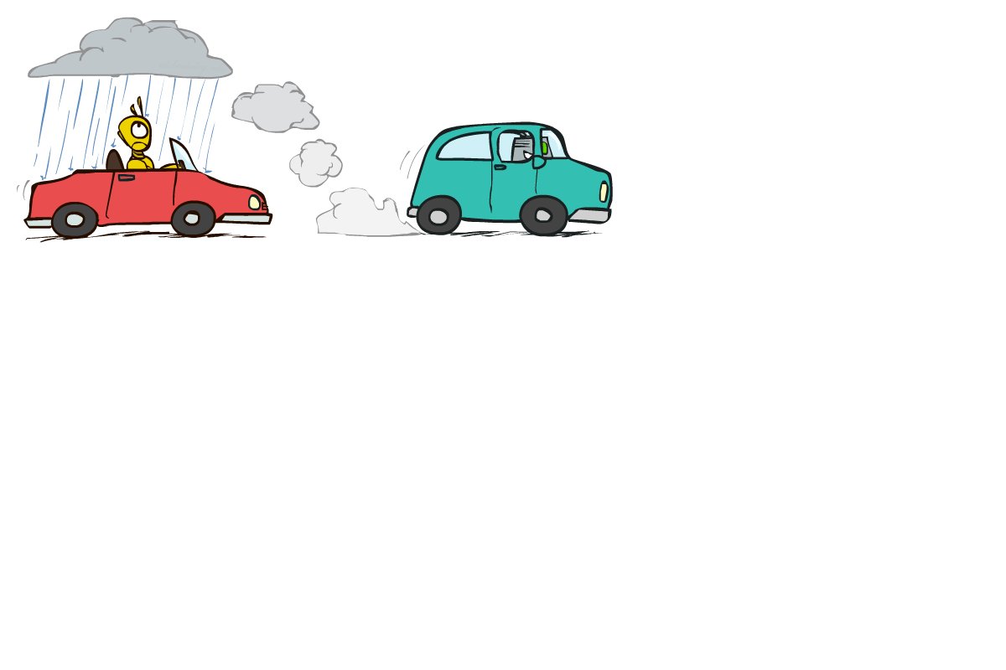

Example: Reverse Traffic
Reverse causality?
T
+t | 9/16
-t | 7/16
+r | +t | 3/16
+r | -t | 1/16
-r | +t | 6/16
-r | -t | 6/16
+t | +r | 1/3
 | -r | 2/3
R
-t | +r | 1/7
 | -r | 6/7

Slide 32
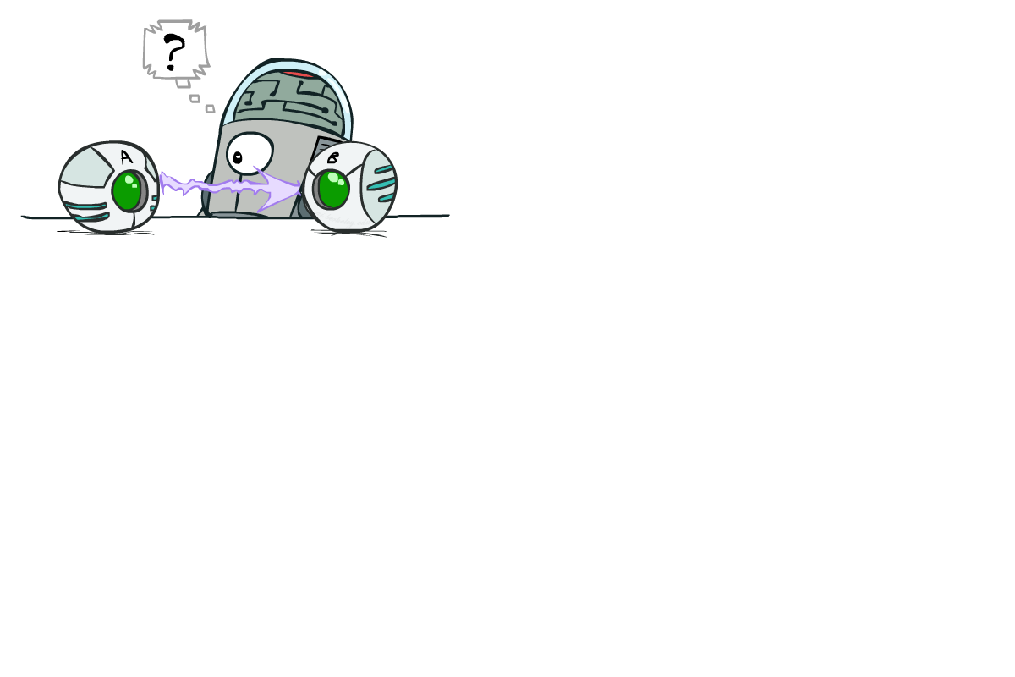
Causality?
When Bayes’ nets reflect the true causal patterns:
Often simpler (nodes have fewer parents)
Often easier to think about
Often easier to elicit from experts
BNs need not actually be causal
Sometimes no causal net exists over the domain (especially if variables are missing)
E.g. consider the variables Traffic and Drips
End up with arrows that reflect correlation, not causation
What do the arrows really mean?
Topology may happen to encode causal structure
Topology really encodes conditional independence

Slide 33

Bayes’ Nets
So far: how a Bayes’ net encodes a joint distribution
Next: how to answer queries about that distribution
Today:
First assembled BNs using an intuitive notion of conditional independence as causality
Then saw that key property is conditional independence
Main goal: answer queries about conditional independence and influence
After that: how to answer numerical queries (inference)

Slide 34

Bayes’ Nets
Representation
Conditional Independences
Probabilistic Inference
Learning Bayes’ Nets from Data

Slide 35


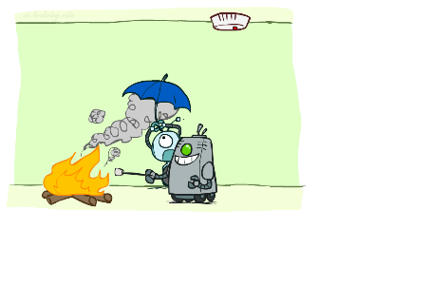

Conditional Independence
X and Y are independent if
X and Y are conditionally independent given Z
(Conditional) independence is a property of a distribution
Example:

Slide 36
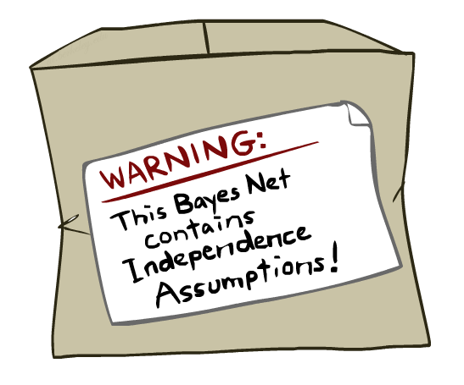
Bayes Nets: Assumptions
Assumptions we are required to make to define the Bayes net when given the graph:
Beyond above “chain rule → Bayes net” conditional independence assumptions
Often additional conditional independences
They can be read off the graph
Important for modeling: understand assumptions made when choosing a Bayes net graph
Notes:
Important for modeling: understanding which assumptions you are making!

Slide 37
Example
X
Y
Z
W
Conditional independence assumptions directly from simplifications in chain rule:
Additional implied conditional independence assumptions?

Slide 38
Independence in a BN
Important question about a BN:
Are two nodes independent given certain evidence?
If yes, can prove using algebra (tedious in general)
If no, can prove with a counter example
Example:
Question: are X and Z necessarily independent?
Answer: no. Example: low pressure causes rain, which causes traffic.
X can influence Z, Z can influence X (via Y)
Addendum: they could be independent: how?
X
Y
Z

Slide 39
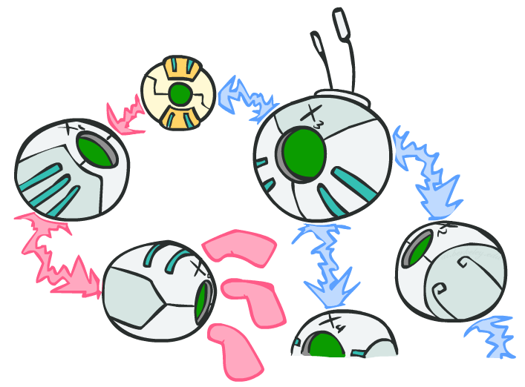
D-separation: Outline

Slide 40
D-separation: Outline
Study independence properties for triples
Analyze complex cases in terms of member triples
D-separation: a condition / algorithm for answering such queries

Slide 41
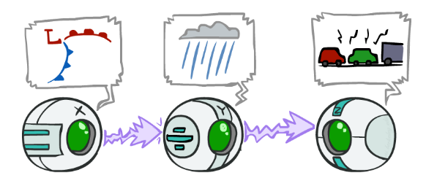
Causal Chains
This configuration is a “causal chain”
Guaranteed X independent of Z ? No!
One example set of CPTs for which X is not independent of Z is sufficient to show this independence is not guaranteed.
Example:
Low pressure causes rain causes traffic,
high pressure causes no rain causes no
traffic
In numbers:
P( +y | +x ) = 1, P( -y | - x ) = 1,
P( +z | +y ) = 1, P( -z | -y ) = 1
X: Low pressure Y: Rain Z: Traffic

Slide 42
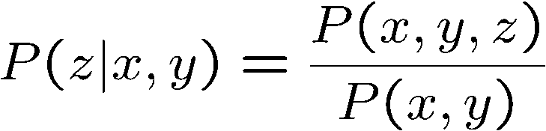
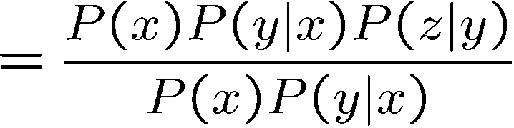

Causal Chains
This configuration is a “causal chain”
Guaranteed X independent of Z given Y?
Evidence along the chain “blocks” the influence
X: Low pressure Y: Rain Z: Traffic
Yes!

Slide 43
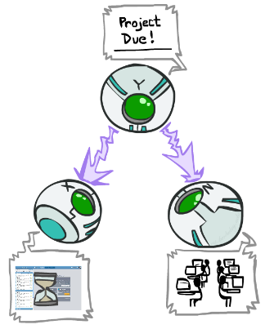
Common Cause
This configuration is a “common cause”
Guaranteed X independent of Z ? No!
One example set of CPTs for which X is not independent of Z is sufficient to show this independence is not guaranteed.
Example:
Project due causes both forums busy
and lab full
In numbers:
P( +x | +y ) = 1, P( -x | -y ) = 1,
P( +z | +y ) = 1, P( -z | -y ) = 1
Y: Project due
X: Forums busy
Z: Lab full

Slide 44
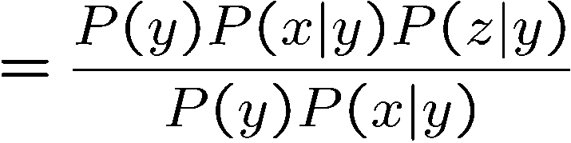
Common Cause
This configuration is a “common cause”
Guaranteed X and Z independent given Y?
Observing the cause blocks influence between effects.
Y: Project due
X: Forums busy
Z: Lab full
Yes!

Slide 45
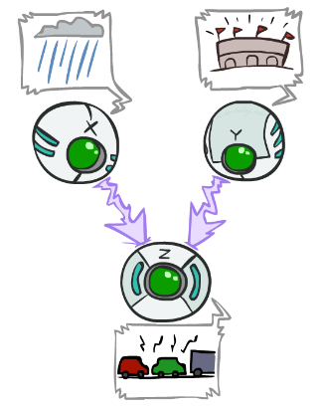
Common Effect
Last configuration: two causes of one effect (v-structures)
Are X and Y independent?
Yes: the ballgame and the rain cause traffic, but they are not correlated
Still need to prove they must be (try it!)
Are X and Y independent given Z?
No: seeing traffic puts the rain and the ballgame in competition as explanation.
This is backwards from the other cases
Observing an effect activates influence between possible causes.
X: Raining
Y: Ballgame
Z: Traffic

Slide 46
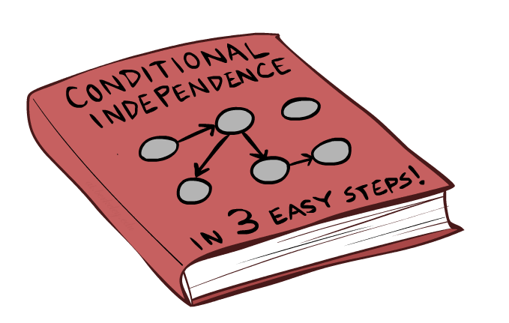
The General Case

Slide 47
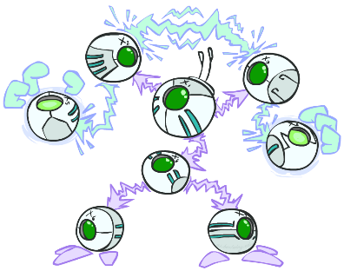
The General Case
General question: in a given BN, are two variables independent (given evidence)?
Solution: analyze the graph
Any complex example can be broken
into repetitions of the three canonical cases

Slide 48


Reachability
L
Recipe: shade evidence nodes, look for paths in the resulting graph
Attempt 1: if two nodes are connected by an undirected path not blocked by a shaded node, they are conditionally independent
Almost works, but not quite
Where does it break?
Answer: the v-structure at T doesn’t count as a link in a path unless “active”
R
B
D
T

Slide 49
Active / Inactive Paths
Question: Are X and Y conditionally independent given evidence variables {Z}?
Yes, if X and Y “d-separated” by Z
Consider all (undirected) paths from X to Y
No active paths = independence!
A path is active if each triple is active:
Causal chain A → B → C where B is unobserved (either direction)
Common cause A ← B → C where B is unobserved
Common effect (aka v-structure)
A → B ← C where B or one of its descendents is observed
All it takes to block a path is a single inactive segment
Active Triples
Inactive Triples

Slide 50



D-Separation
?
Query:
Check all (undirected!) paths between and
If one or more active, then independence not guaranteed
Otherwise (i.e. if all paths are inactive),
then independence is guaranteed

Slide 51


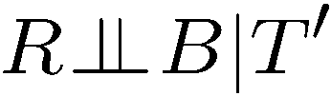
Example
Yes
R
B
T
T’
Notes:
T’: traffic report

Slide 52
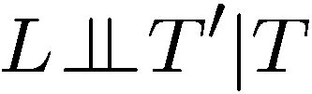


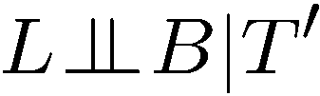

Example
L
Yes
R
B
Yes
D
T
Yes
T’

Slide 53



Example
Variables:
R: Raining
T: Traffic
D: Roof drips
S: I’m sad
Questions:
R
T
D
S
Yes

Slide 54

Structure Implications
Given a Bayes net structure, can run d-separation algorithm to build a complete list of conditional independences that are necessarily true of the form
This list determines the set of probability distributions that can be represented

Slide 55

Computing All Independences
Y
X
Z
Y
X
Z
X
Z
Y
Y
X
Z

Slide 56
Topology Limits Distributions
Given some graph topology G, only certain joint distributions can be encoded
The graph structure guarantees certain (conditional) independences
(There might be more independence)
Adding arcs increases the set of distributions, but has several costs
Full conditioning can encode any distribution
Y
Y
X
Z
X
Z
Y
X
Z
Y
X
Z
Y
Y
Y
X
Z
X
Z
X
Z
Y
Y
Y
X
Z
X
Z
X
Z

Slide 57
Bayes Nets Representation Summary
Bayes nets compactly encode joint distributions
Guaranteed independencies of distributions can be deduced from BN graph structure
D-separation gives precise conditional independence guarantees from graph alone
A Bayes’ net’s joint distribution may have further (conditional) independence that is not detectable until you inspect its specific distribution

Slide 58
Bayes’ Nets
Representation
Conditional Independences
Probabilistic Inference
Enumeration (exact, exponential complexity)
Variable elimination (exact, worst-case
exponential complexity, often better)
Probabilistic inference is NP-complete
Sampling (approximate)
Learning Bayes’ Nets from Data

